Slide 1
Puppet

Slide 2
Why do we need Puppet ?
As system administrators acquire more and more systems to manage, automation of mundane tasks is increasingly important. Rather than develop in-house scripts, it is desirable to share a system that everyone can use, and invest in tools that can be used regardless of one’s employer. Certainly doing things manually doesn’t scale.
Puppet has been developed to help the sysadmin community move to building and sharing mature tools that avoid the duplication of everyone solving the same problem. It does so in two ways:
It provides a powerful framework to simplify the majority of the technical tasks that sysadmins need to perform.
The sysadmin work is written as code in Puppet’s custom language which is shareable just like any other code.

Slide 3
What is Puppet ?
Puppet manages your infrastructure. You describe configurations in an easy-to-read declarative language, and Puppet will bring your systems into the desired state and keep them there.
A Configuration Management Tool
A framework for Systems Automation
A Declarative Domain Specific Language (DSL)
An OpenSource software in written Ruby
Works on Linux, Unix (Solaris, AIX, *BSD), MacOS, Windows (Supported Platforms)
Developed by Puppet Labs

Slide 4
Configuration Management advantages
Infrastructure as Code: Track, Test, Deploy, Reproduce, Scale
Code commits log shows the history of change on the infrastructure
Reproducible setups: Do once, repeat forever
Scale quickly: Done for one, use on many
consistent server setups
Aligned Environments for devel, test, qa, prod nodes
Alternatives to Puppet: Chef, CFEngine, Salt, Ansible

Slide 5
How Puppet Works ?
Puppet is typically (but not always) used in a client/server formation, with all of your clients talking to one or more central servers. Each client contacts the server periodically (every half hour, by default), downloads the latest configuration, and makes sure it is in sync with that configuration. Once done, the client can send a report back to the server indicating if anything needed to change.

Slide 6
Overview of Puppet's architecture
You can configure systems with Puppet either in a client/server architecture, using the Puppet agent and Puppet master applications, or in a stand-alone architecture, using the Puppet apply application.

Slide 7
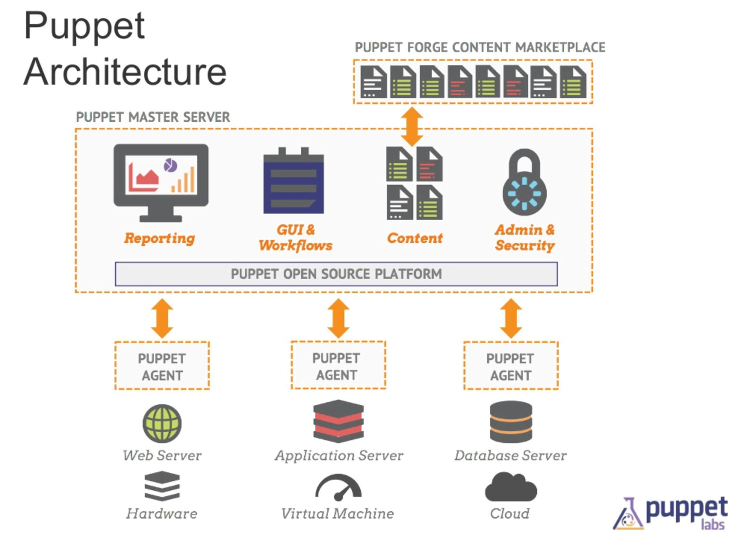
Puppet Architecture

Slide 8
The agent/master architecture
When set up as an agent/master architecture, a Puppet master server controls the configuration information, and each managed agent node requests its own configuration catalog from the master.
In this architecture, managed nodes run the Puppet agent application, usually as a background service. One or more servers run the Puppet master application, Puppet Server.
Periodically, each Puppet agent sends facts to the Puppet master, and requests a catalog. The master compiles and returns that node’s catalog, using several sources of information it has access to.
Once it receives a catalog, Puppet agent applies it to the node by checking each resource the catalog describes. If it finds any resources that are not in their desired state, it makes the changes necessary to correct them. Or, in no-op mode, it reports on what changes would have been done.
After applying the catalog, the agent sends a report to the Puppet master.

Slide 9
Communications and security
Puppet agent nodes and Puppet masters communicate by HTTPS with client verification.
The Puppet master provides an HTTP interface, with various endpoints available. When requesting or submitting anything to the master, the agent makes an HTTPS request to one of those endpoints.
Client-verified HTTPS means each master or agent must have an identifying SSL certificate. They each examine their counterpart’s certificate to decide whether to allow an exchange of information.
Puppet includes a built-in certificate authority for managing certificates. Agents can automatically request certificates through the master’s HTTP API. You can use the puppet cert command to inspect requests and sign new certificates. And agents can then download the signed certificates.

Slide 10
The stand-alone architecture
Puppet can run in a stand-alone architecture, where each managed node has its own complete copy of your configuration info and compiles its own catalog.
In this architecture, managed nodes run the Puppet apply application, usually as a scheduled task or cron job. You can also run it on demand for initial configuration of a server or for smaller configuration tasks.
Like the Puppet master application, Puppet apply needs access to several sources of configuration data, which it uses to compile a catalog for the node it is managing.
After Puppet apply compiles the catalog, it immediately applies it by checking each resource the catalog describes. If it finds any resources that are not in their desired state, it makes the changes necessary to correct them. Or, in no-op mode, it reports on what changes would have been needed.
After applying the catalog, Puppet apply stores a report on disk. You can configure it to send reports to a central service.

Slide 11
Catalogs
A catalog is a document that describes the desired system state for one specific computer. It lists all of the resources that need to be managed, as well as any dependencies between those resources.
Puppet configures systems in two stages:
Compile a catalog.
Apply the catalog.

Slide 12
Language: Basics
Puppet uses its own configuration language, which was designed to be accessible to system admins. The Puppet language does not require much formal programming experience and its syntax was inspired by the Nagios configuration file format.

Slide 13
Resources, classes, and nodes
The core of the Puppet language is declaring resources. Every other part of the language exists to add flexibility and convenience to the way resources are declared.
Groups of resources can be organized into classes, which are larger units of configuration. While a resource might describe a single file or package, a class can describe everything needed to configure an entire service or application (including any number of packages, config files, service daemons, and maintenance tasks). Smaller classes can then be combined into larger classes which describe entire custom system roles, such as “database server” or “web application worker.”
Nodes that serve different roles will generally get different sets of classes. The task of configuring which classes will be applied to a given node is called node classification. Nodes can be classified in the Puppet language using node definitions; they can also be classified using node-specific data from outside your manifests, such as that from an ENC or Hiera.

Slide 14
Ordering
Although Puppet’s language is built around describing resources (and the relationships between them) in a declarative way, several parts of the language do depend on evaluation order. The most notable of these are variables, which must be set before they are referenced.

Slide 15
Files
Puppet language files are called manifests, and are named with the .pp file extension. Manifest files:
Must use UTF8 encoding
Can use Unix (LF) or Windows (CRLF) line breaks (note that the line break format also affects literal line breaks in strings)
Puppet always begins compiling with the main manifest, which can be either a single file or a directory containing several files. (Some documents also call this the “site manifest.”) See the reference page on the main manifest for details about this special file/directory.
Any classes declared in the main manifest can be autoloaded from manifest files in modules. Puppet will also autoload any classes declared by an optional external node classifier. See the reference page on catalog compilation for details.
The simplest Puppet deployment is a lone main manifest file with a few resources. Complexity can grow progressively, by grouping resources into modules and classifying your nodes more granularly.

Slide 16
Modules
A module is a collection of manifests and data (such as facts, files, and templates), and they have a specific directory structure. Modules are useful for organizing your Puppet code, because they allow you to split your code into multiple manifests. It is considered best practice to use modules to organize almost all of your Puppet manifests.
To add a module to Puppet, place it in the /etc/puppet/modules directory.

Slide 17
Compilation and catalogs
Puppet manifests can use conditional logic to describe many nodes’ configurations at once. Before configuring a node, Puppet compiles manifests into a catalog, which is only valid for a single node and which contains no ambiguous logic.
Catalogs are static documents which contain resources and relationships. At various stages of a Puppet run, a catalog will be in memory as a Ruby object, transmitted as JSON, and persisted to disk as YAML. The catalog format used by this version of Puppet is not documented and does not have a spec.
In the standard agent/master architecture, nodes request catalogs from a Puppet master server, which compiles and serves them to nodes as needed. When running Puppet standalone with Puppet apply, catalogs are compiled locally and applied immediately.
Agent nodes cache their most recent catalog. If they request a catalog and the master fails to compile one, they will re-use their cached catalog. This recovery behavior is governed by the usecacheonfailure setting in puppet.conf. When testing updated manifests, you can save time by turning it off.

Slide 18
Example
The following short manifest manages NTP. It uses package, file, and service resources; a case statement based on a fact; variables; ordering and notification relationships; and file contents being served from a module.
case $operatingsystem {
centos, redhat: { $service_name = 'ntpd' }
debian, ubuntu: { $service_name = 'ntp' }
}
package { 'ntp':
ensure => installed,
}
service { 'ntp':
name => $service_name,
ensure => running,
enable => true,
subscribe => File['ntp.conf'],
}
file { 'ntp.conf':
path => '/etc/ntp.conf',
ensure => file,
require => Package['ntp'],
source => "puppet:///modules/ntp/ntp.conf",
# This source file would be located on the Puppet master at
# /etc/puppetlabs/code/modules/ntp/files/ntp.conf
}

Slide 19
Installation
Installation on Ubuntu, Debian:
apt-get install puppet # On clients (nodes)
apt-get install puppetmaster # On server (master)
Installation on RHEL, CentOS:
yum install puppet # On clients (nodes)
yum install puppet-server # On server (master)

Slide 20
Assignment
Follow the instruction in the below link and setup a Standalone environment:
https://www.digitalocean.com/community/tutorials/how-to-set-up-a-masterless-puppet-environment-on-ubuntu-14-04

